Slide 1

Hotel Management System Group Number - 07
Monowar Islam
Reg No: 1002
Exam Roll: 3368
Sajid Afnan
Reg No: 1017
Exam Roll: 3364

Slide 2
Motivation Languages Interface Feature Future Plan Summary
Contents

Slide 3

Motivation

Slide 4
Languages & Framework
Frontend
backend
Database
Node js
Mongodb
HTML5
CSS
Bootstrap
Javascripts
ReactJs
Firebase

Slide 5
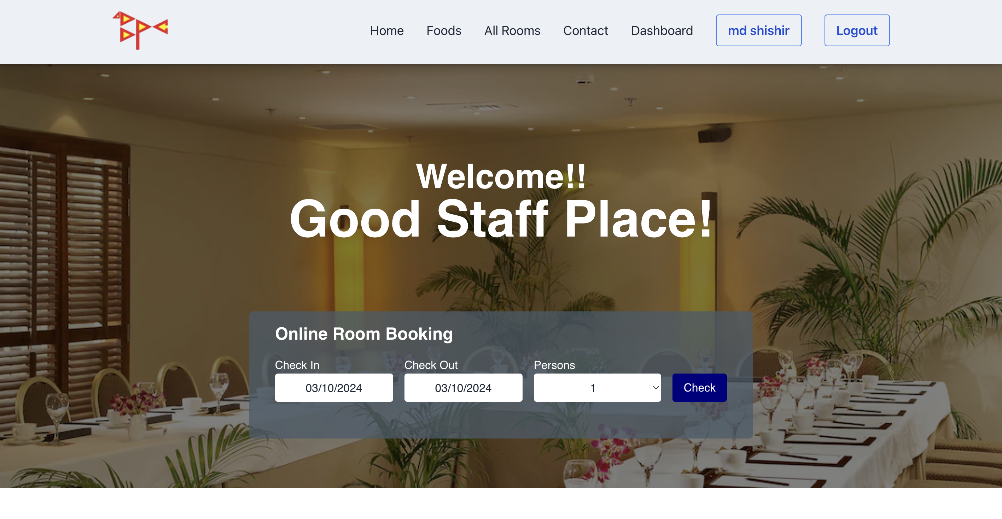
Home Page & Booking Page

Slide 6
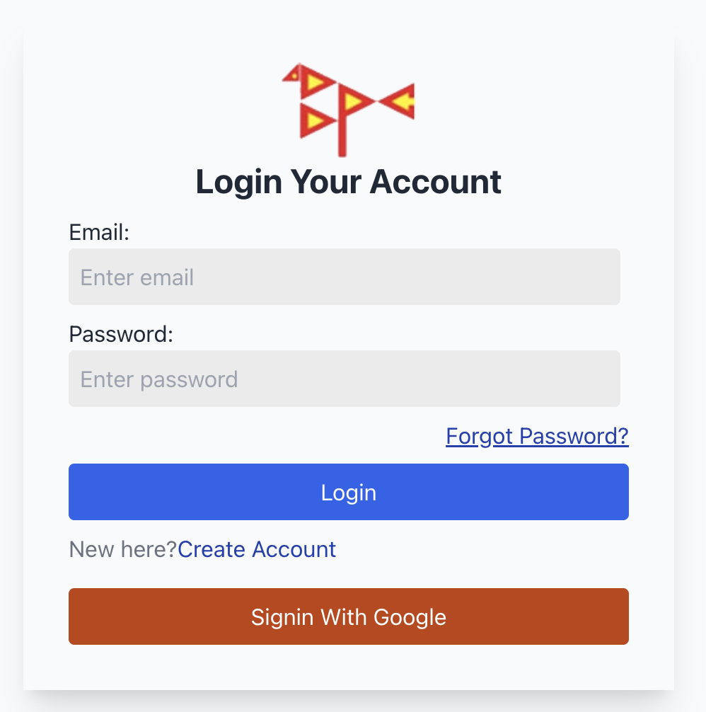
Login Page

Slide 7
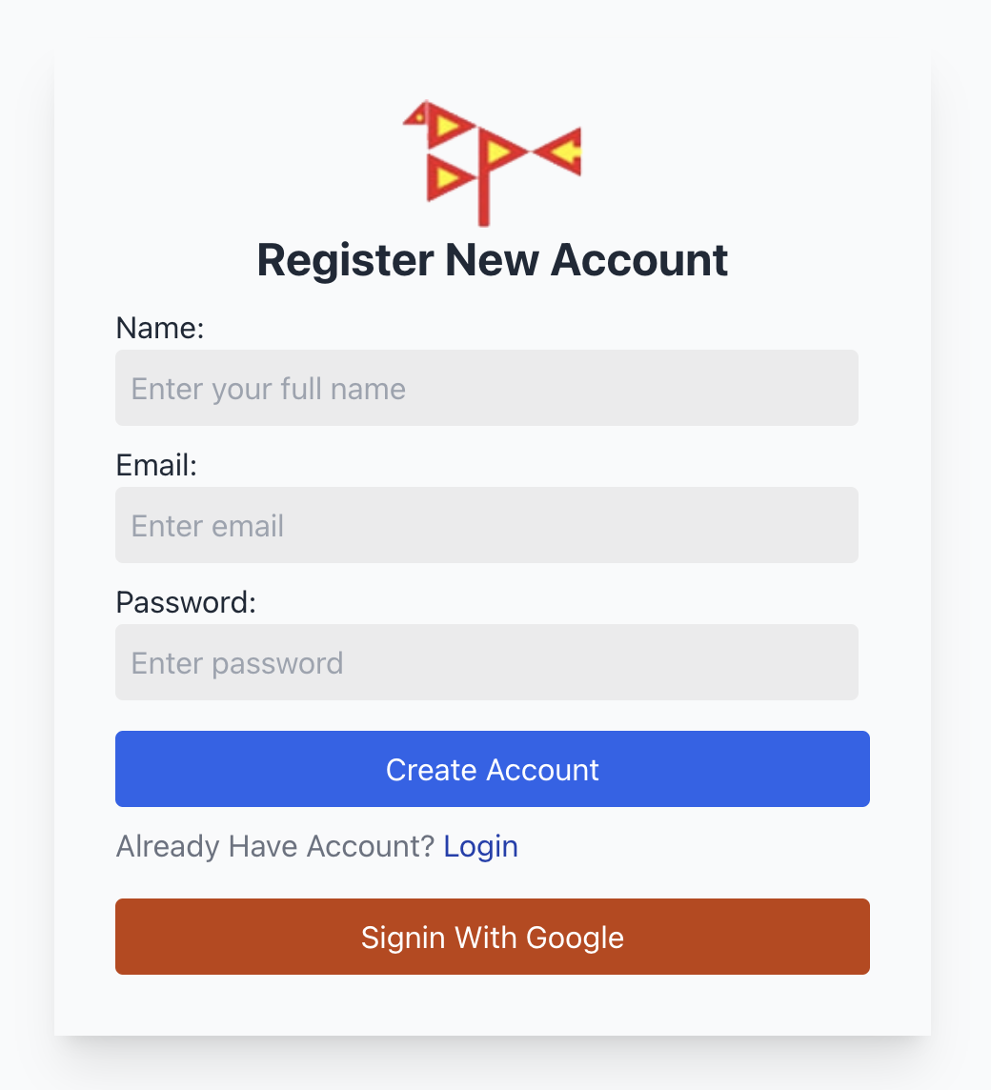
Signup Page

Slide 8
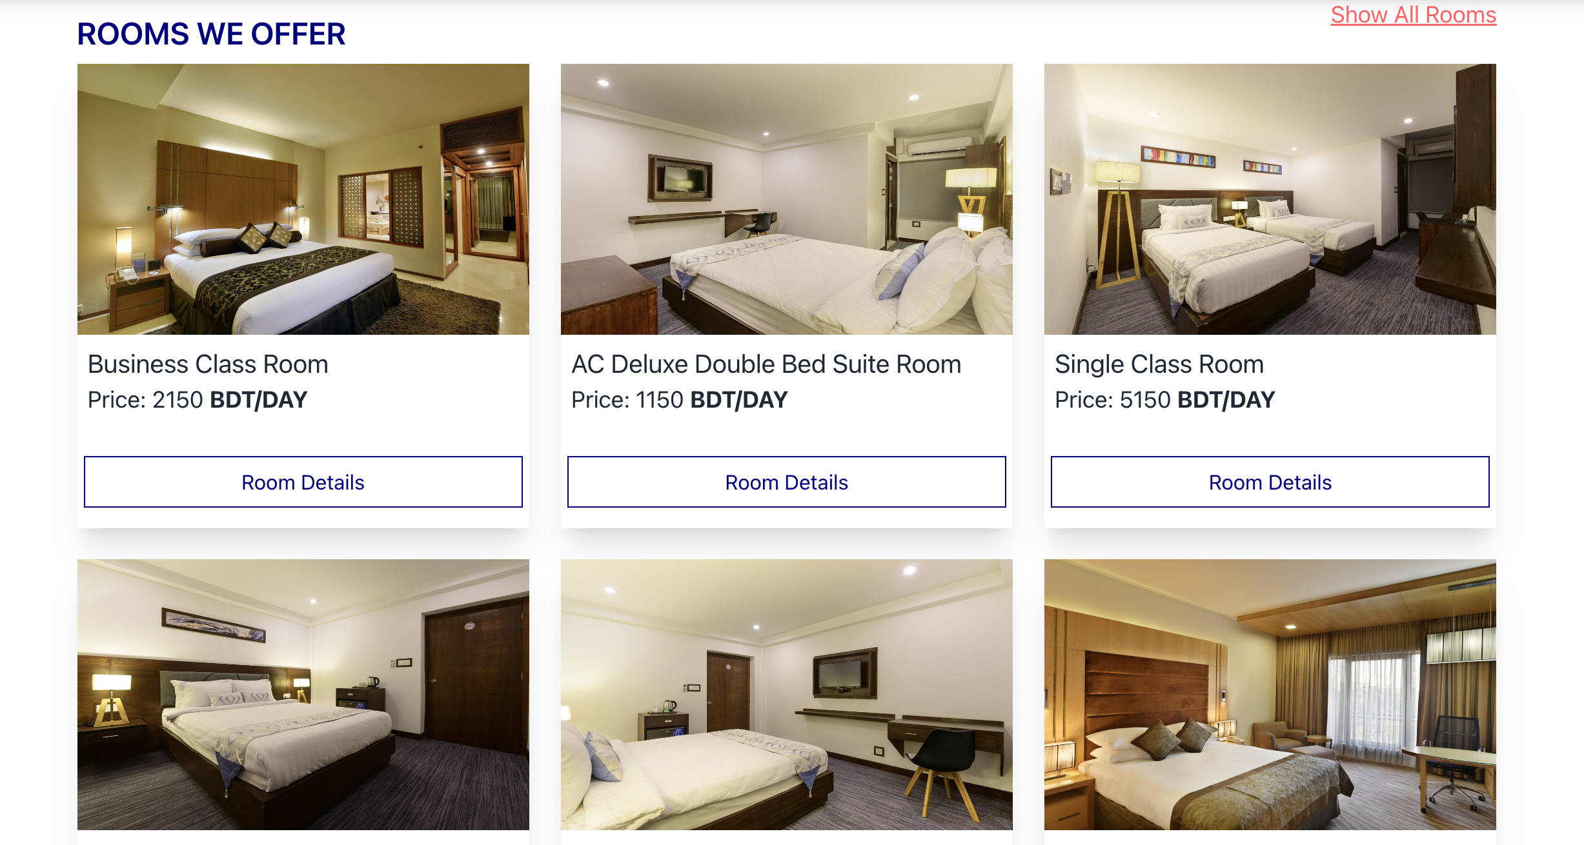
Rooms

Slide 9
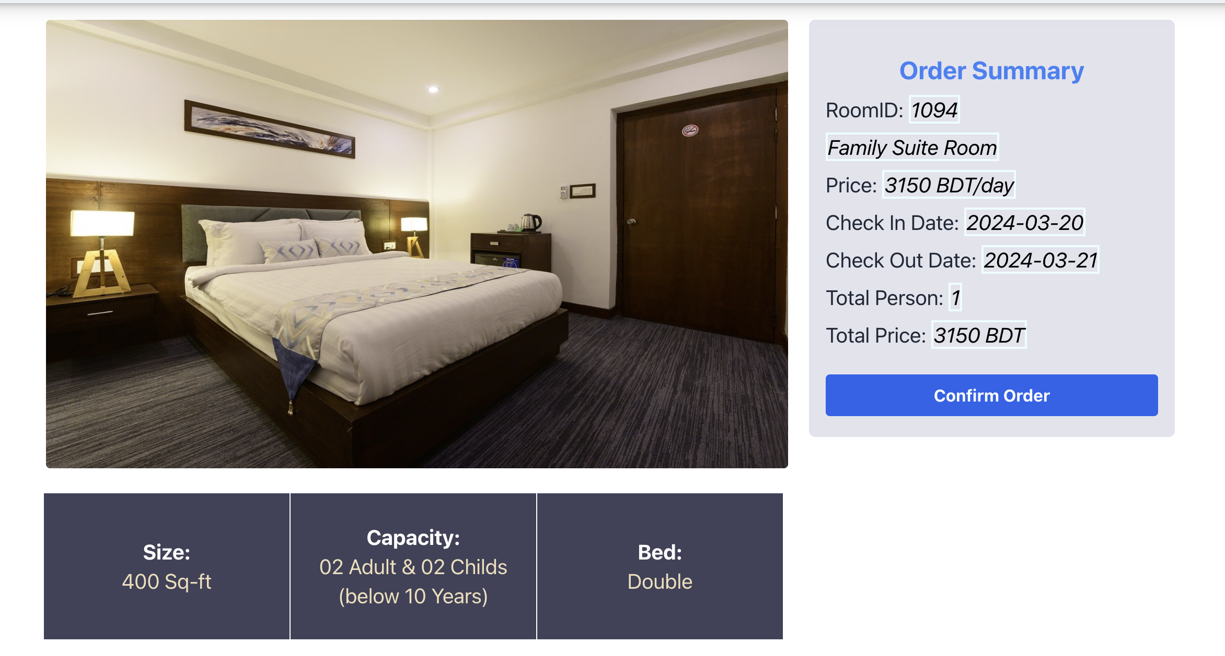
Rooms Details

Slide 10
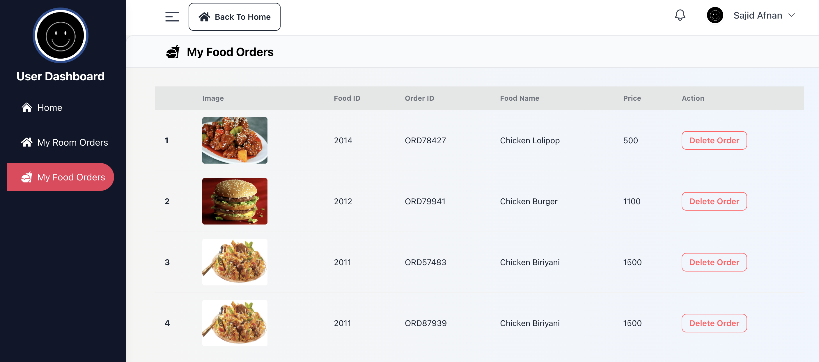
Dashboard

Slide 11
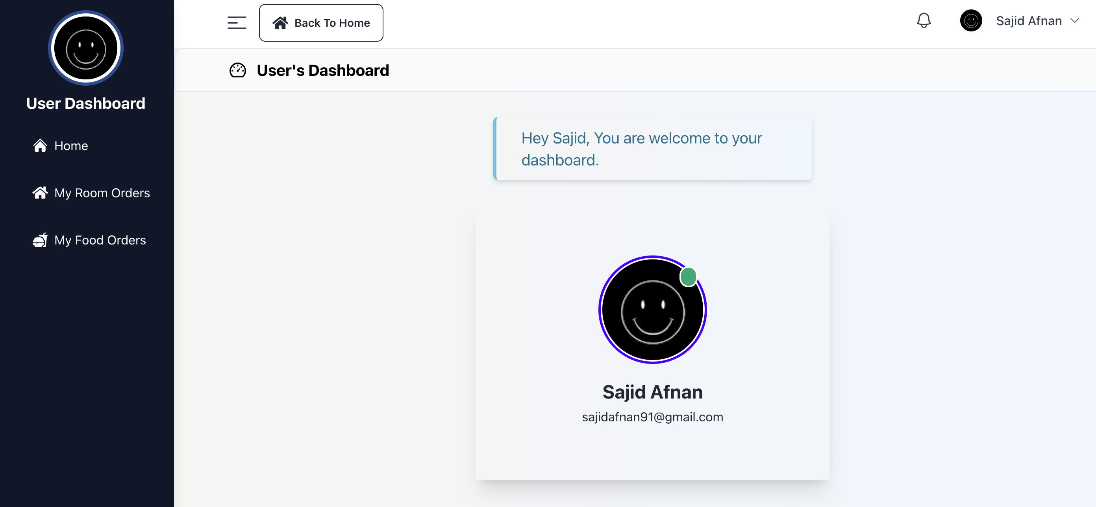
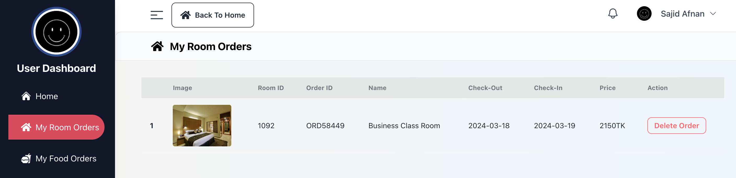
Dashboard

Slide 12
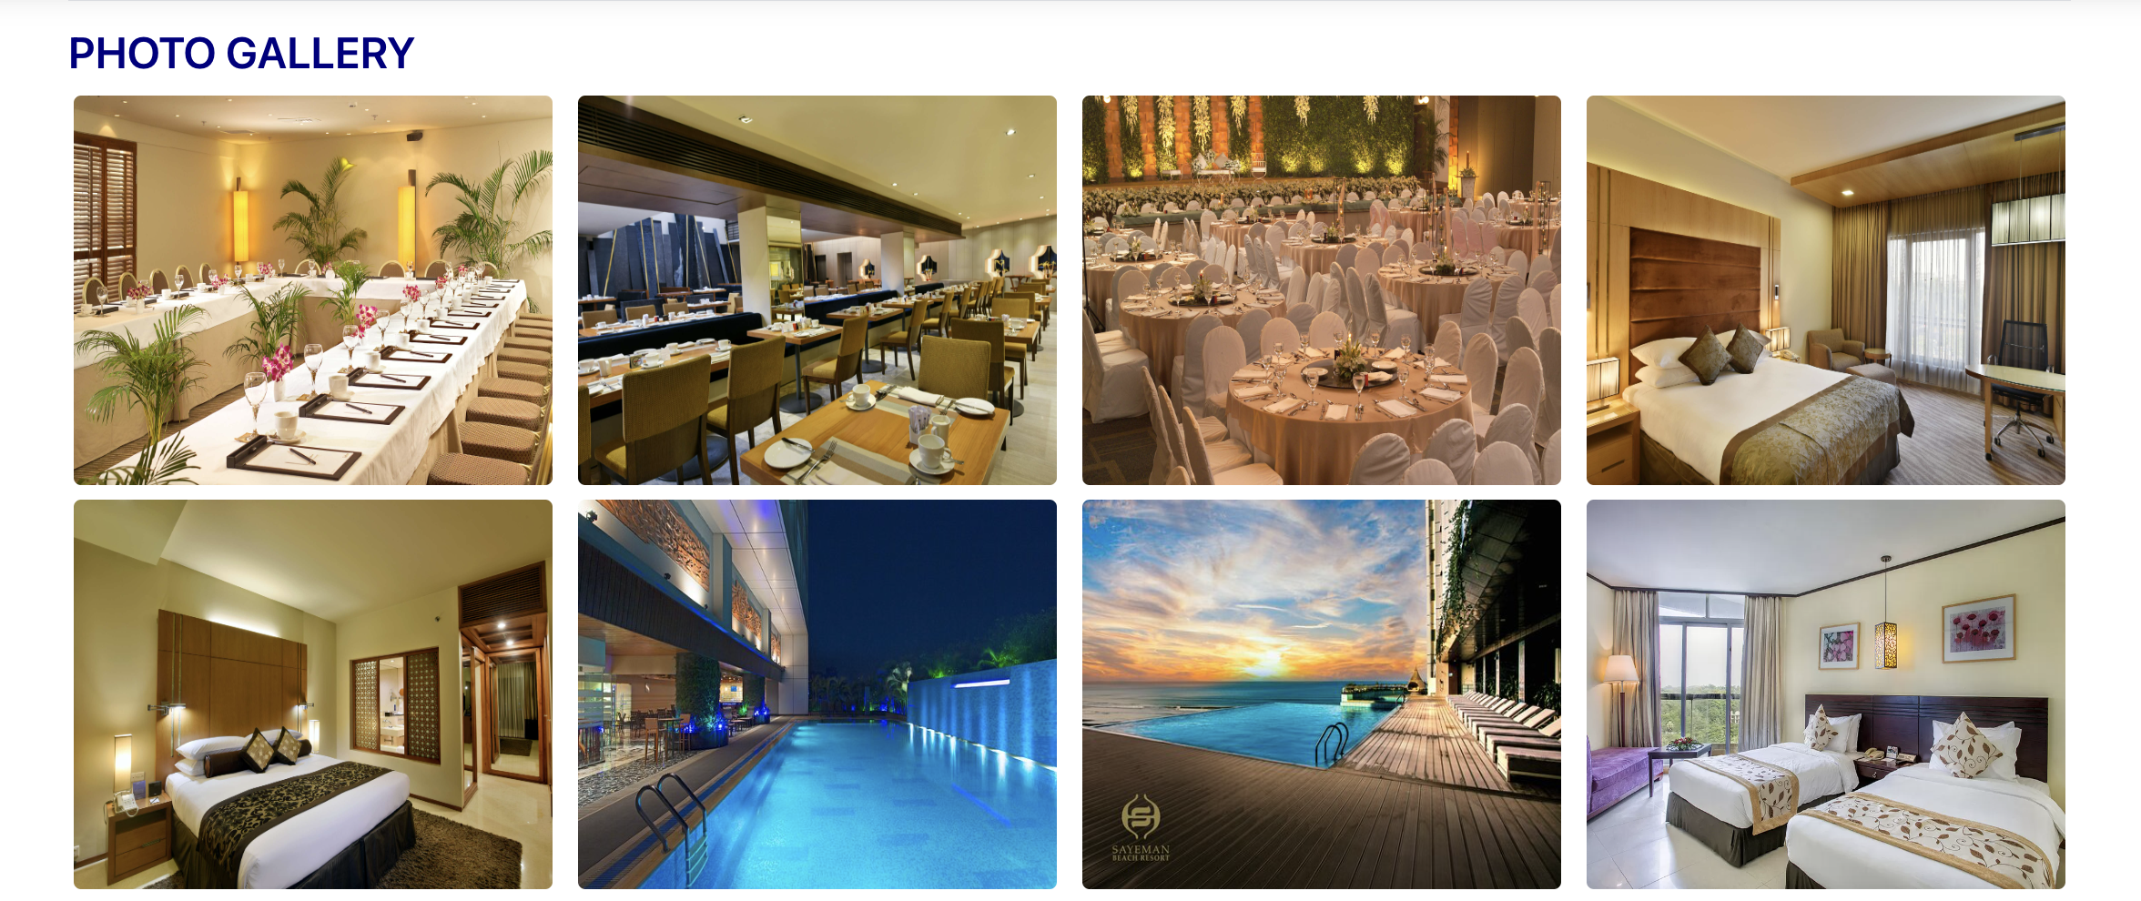
Gallery

Slide 13
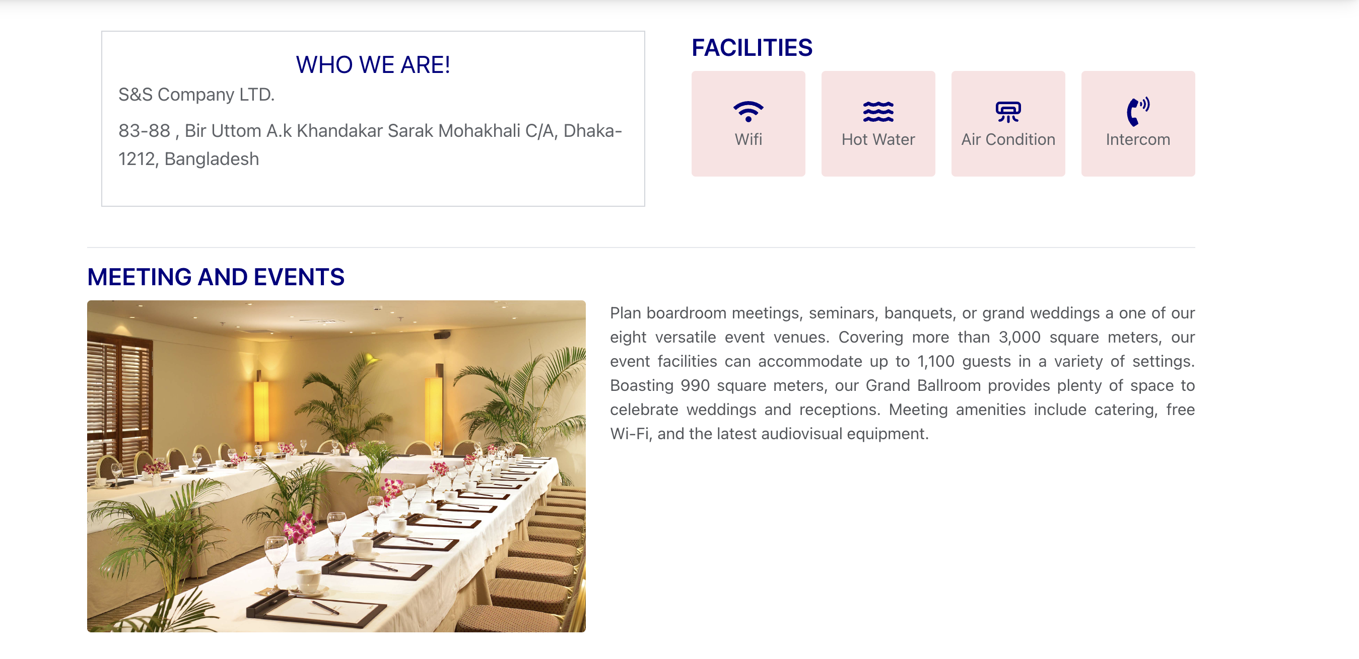
Feature

Slide 14
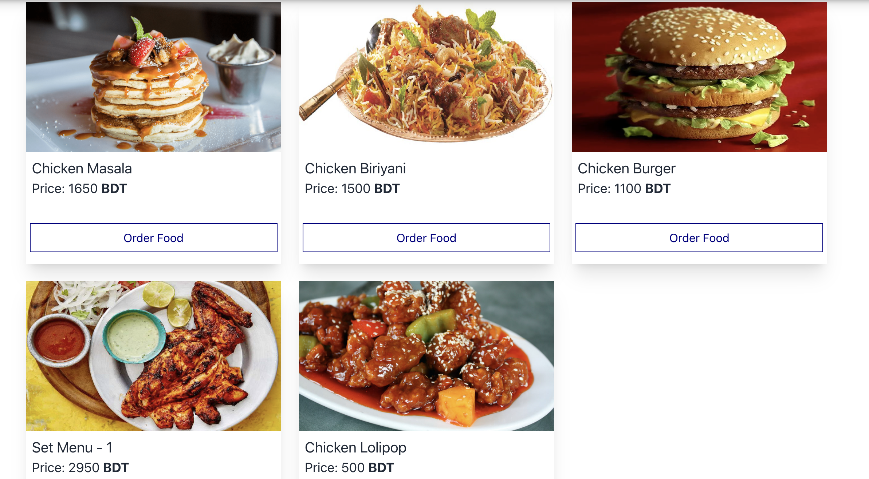
Also..

Slide 15
Future Plan
Transaction Process
Including more hotel
Security
Service

Slide 16
Summary
The hotel management project optimizes operations like reservations, check-in/out, inventory, billing, and reporting. It aims to boost efficiency, elevate guest satisfaction, and increase revenue through centralized management and process automation.

